Slide 1

Linear Regression

Slide 2
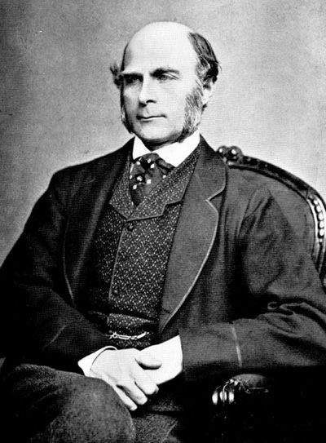
History
This all started in the 1800s with a guy named Francis Galton. Galton was studying the relationship between parents and their children. In particular, he investigated the relationship between the heights of fathers and their sons.

Slide 3
History
What he discovered was that a man's son tended to be roughly as tall as his father.
However Galton's breakthrough was that the son's height tended to be closer to the overall average height of all people.

Slide 4

Example
Let's take Shaquille O'Neal as an example. Shaq is really tall:7ft 1in (2.2 meters).
If Shaq has a son, chances are he'll be pretty tall too. However, Shaq is such an anomaly that there is also a very good chance that his son will be not be as tall as Shaq.

Slide 5
Example
Turns out this is the case: Shaq's son is pretty tall (6 ft 7 in), but not nearly as tall as his dad.
Galton called this phenomenon regression, as in "A father's son's height tends to regress (or drift towards) the mean (average) height."

Slide 6
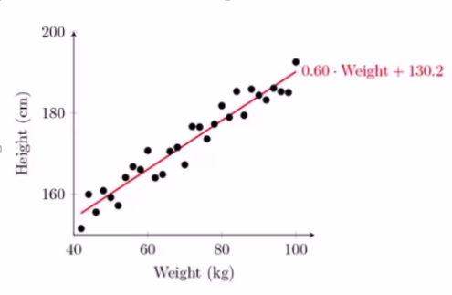
Regression
Fit a line to set of observations
Use this line to predict unobserved data values

Slide 7
How does it work?
Usually using “least square method”
Minimize the squared error between each point and line
Based on Slope intercept line y=mx+b

Slide 8
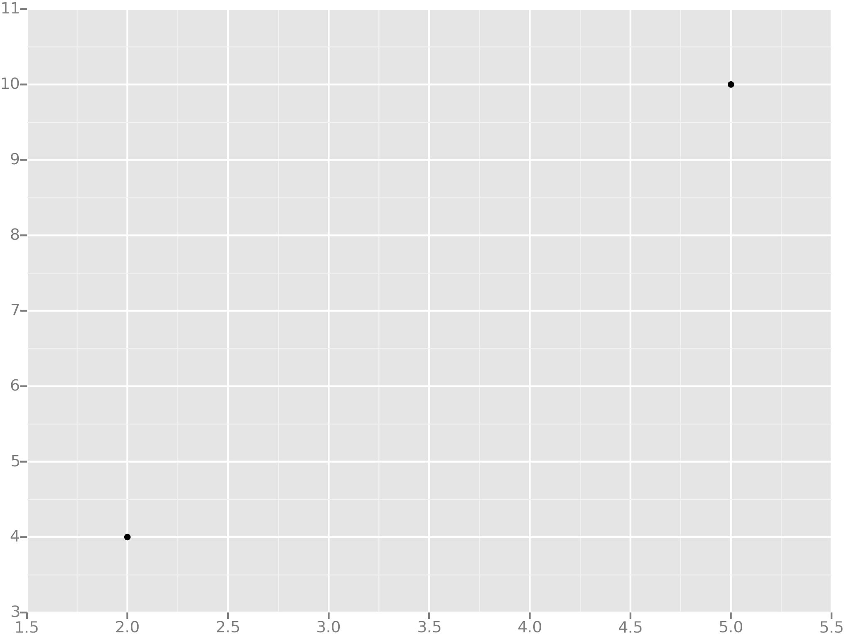
Example
Let's take the simplest possible example: calculating a regression with only 2 data points.

Slide 9
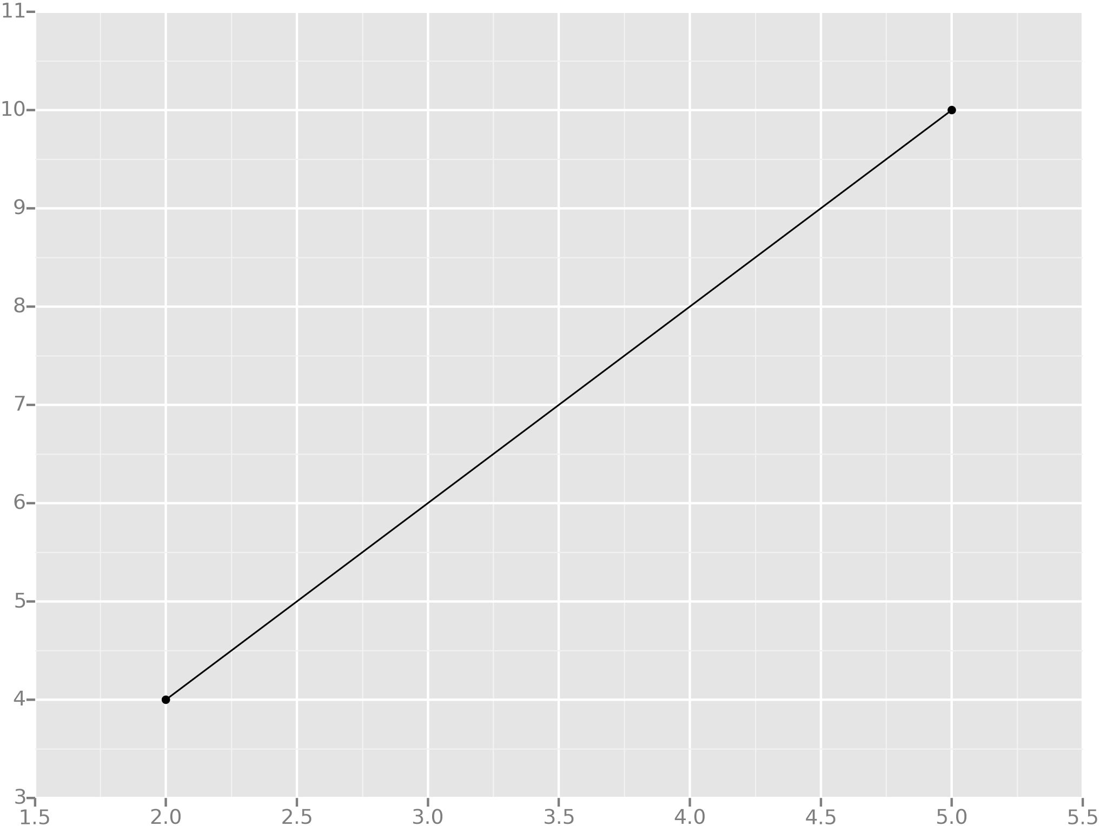
Example
All we're trying to do when we calculate our regression line is draw a line that's as close to every dot as possible.
For classic linear regression, or "Least Squares Method", you only measure the closeness in the "up and down" direction

Slide 10
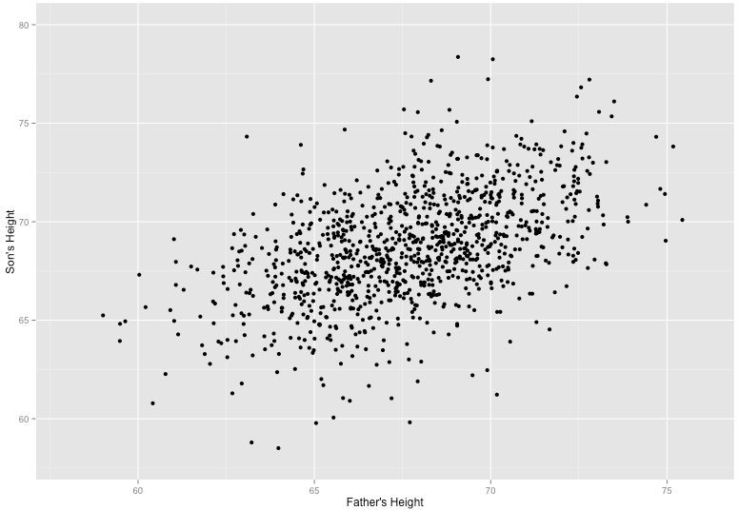
Example
Now wouldn't it be great if we could apply this same concept to a graph with more than just two data points?
By doing this, we could take multiple men and their son's heights and do things like tell a man how tall we expect his son to be...before he even has a son!

Slide 11
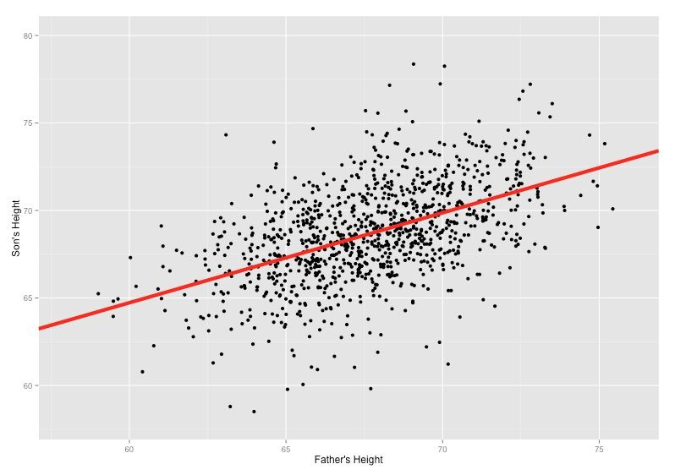
Example
Our goal with linear regression is to minimize the vertical distance between all the data points and our line.
So in determining the best line, we are attempting to minimize the distance between all the points and their distance to our line.

Slide 12
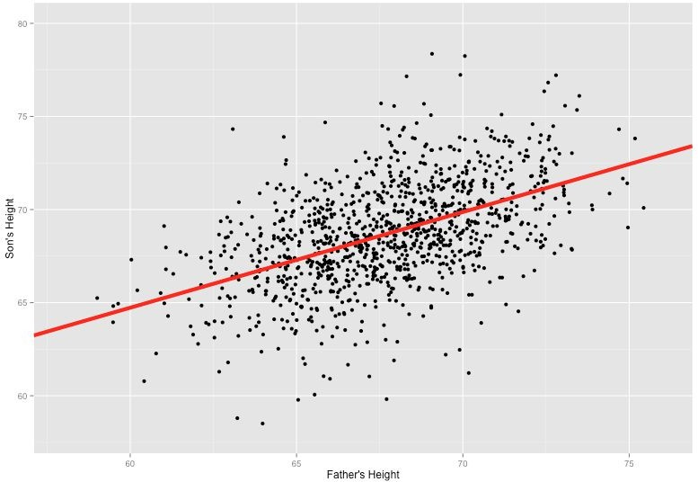
Example
There are lots of different ways to minimize this, (sum of squared errors, sum of absolute errors, etc), but all these methods have a general goal of minimizing this distance.

Slide 13



Example
For example, one of the most popular methods is the least squares method.
Here we have blue data points along an x and y axis.

Slide 14
Example
Now we want to fit a linear regression line.
The question is, how do we decide which line is the best fitting one?

Slide 15
Example
We’ll use the Least Squares Method, which is fitted by minimizing the sum of squares of the residuals.
The residuals for an observation is the difference between the observation (the y-value) and the fitted line.

Slide 16
Interesting Readings (Must)
https://towardsdatascience.com/linear-regression-detailed-view-ea73175f6e86
https://ml-cheatsheet.readthedocs.io/en/latest/linear_regression.html (includes mathematical stuff)

Slide 17
Reading (Optional)
Chapters 2 & 3 of
Introduction to Statistical Learning
By Gareth James, et al.

